Slide 1
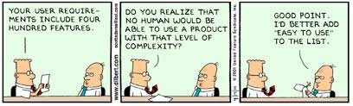
Scope Management
Phil Pfeiffer
Fall, 2014

Slide 2
Scope Management
Doing the work, all the work, and nothing but the work … subject to project constraints
Key elements (PMBOK)
1. Collecting requirements
2. Defining project scope
3. Creating work breakdown structure (WBS)
4. Verifying the scope
5. Controlling the scope

Slide 3
1. Requirements Gathering
cf. CSCI 5200, Software Systems Engineering
Key question: how much needed to start?
▪ Different authorities, different answers
▪ Some cite Pareto principle (80%)
▪ Some cite strong Pareto principle
(80% very well understood)
▪ Some say as much as possible
▪ Some say, just wing it…
▪ Different projects yield different answers?
Other key questions:
▪ How does a cost center fund requirements gathering?
▪ How do we know we've reached 80%?

Slide 4
2. Defining Project Scope
Inputs: project charter, requirements, organizational assets
Outputs: project scope statement
▪ What's included
▪ What's excluded
Ideally
▪ determined through negotiation after
▪ careful assessment of requirements, including
▪ detailed estimates of tasks and their uncertainty
▪ assessment of resources and deadlines
▪ prioritization of requirements based on above
To be covered at greater length later…

Slide 5
Aside: Bob Lewis on Project Scope
The biggest secret to successful project management:
Don't ever charter a big project.
Definition
▪ More than a dozen people for more than a year
Issues: Big projects
▪ can't be estimated
▪ mean no urgency
▪ reduce personal accountability
▪ mean big overhead
▪ mean big risks

Slide 6
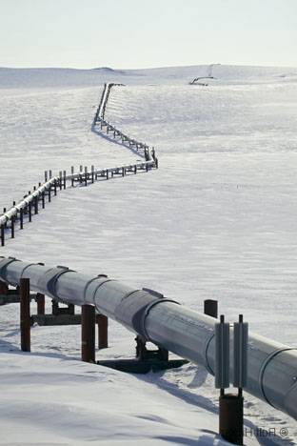
Big Projects Can't Be Estimated
Big integrators can sometimes get away with estimating a big project
▪ If they've done something highly similar before
▪ Case in point: oil pipelines
▪ routine job in "normal" climates (Petroski)
▪ Alaska pipeline
▪ slipped from 1972 to 1977
▪ cost rose from est. $900M (1969) to $8.5B (1977)
▪ issues: project novelty, mismanagement
Sources: Petroski, To Engineer is Human; https://docs.google.com/viewer?a=v&q=cache:G0m5nbtda8UJ:proxy.bookfi.org/genesis/165000/f3fd2d71f13bfc720220b2ce48e3db3c/_as/%255BLouis_Goodman,_Rufino_Ignacio%255D_Engineering_projec(BookFi.org).pdf+%2Bpetroski+%2B%22alaska+pipeline%22+%2Boverrun&hl=en&gl=us&pid=bl&srcid=ADGEESjgqGCv7s6f46KsyQZ3d6QJpAOg17Crt_tFJuvLHSA6fA40q3D3LAWPu6zbGhPxmIZcUIzGUHvDqnrbeXwClUMcQqlZ2jj9aGs71xp9fd3Q02wW2osF7tolcnA_cua1ghTfruCI&sig=AHIEtbTLEmkT7cVYSWfJHaVAryrynHF4eg

Slide 7
Big Projects Can't Be Estimated
Making a guess can get you slaughtered later on
Any number spoken in earshot of a company executive
is immediately etched in granite. -- Bob Lewis
What doesn't matter
▪ What weasel words precede the number.
▪ How many caveats you utter.
▪ How often you against taking the number too seriously.
Big Projects Mean No Urgency
Deadlines important for motivating people to work at their hardest

Slide 8
Big Projects Reduce Accountability
Lots of people ➔ easier to hide
"Milling about smartly"
Big Projects Mean Big Overhead
Overhead of inter-team communication rises superlinearly with team size
Big Projects Mean Big Risks
Project extends further into future ➔ more unknowns
More unknowns ➔ more risks

Slide 9
Lewis' Alternative
Manage big project as succession of small projects
▪ No longer than 9 months for projects with deliverables
▪ No longer than 5 months for studies,
to reduce shifts in assumptions
Limit team size
▪ Preferred: 5-7 participants
▪ 9 full-time participants max

Slide 10
3. Defining a WBS
Inputs:
▪ requirements
▪ scope statement
▪ organizational assets
Outputs:
▪ Work breakdown structure (WBS)
▪ Work breakdown structure dictionary
▪ can include schedule milestones and activities, required resources, cost & quality estimates, & more
▪ Scope baseline = scope stmt. + WBS + WBS dictionary
▪ (perhaps) updates to requirements, other project documents

Slide 11
Types of WBSes
Process WBS
  decomposes a process into smaller more manageable tasks
  each element represents process or activity at some level of detail
  leaf-level elements represent work packages
    Burris's guideline: 1-2 individuals in 1-2 weeks
    Actual time frames should be driven by requirements for process control
Product WBS
  decomposes a product or entity into its constituent parts.
  intended to provide implementers with better understanding of deliverable
Hybrid WBS
  alternating layers of processes and products
  idea: processes produce products
(source: http://www1.sce.umkc.edu/~burrise/pl/project-management/)

Slide 12
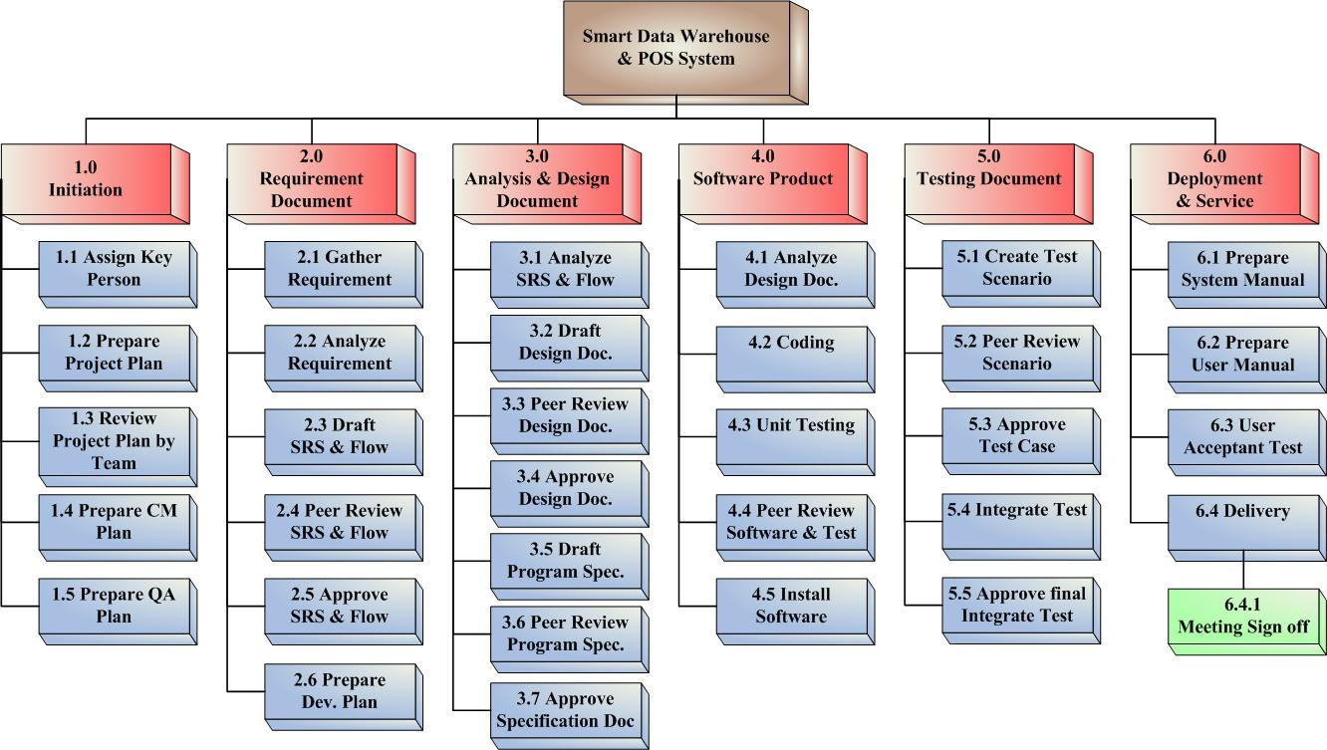
Sample Process WBS

Slide 13
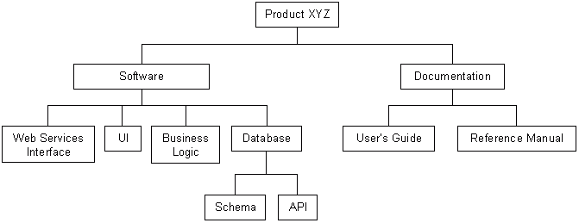
Sample Product WBS

Slide 14
Steps for Creating WBSes
Identify what WBS should accomplish
  Identify assignable units of work?
  Better understand process or products?
  Estimate product size, required effort, and/or cost?
  Reduce risks?
  Exercise better control over the project?
Decide on format: process, product or hybrid WBS
Decompose elements until desired level of granularity is reached.
  "Desired" driven partially by the purpose for creating the WBS.
  Goals
    small enough to be estimated
    small enough to be assigned to one or two individuals.
    appropriate to these individuals' needs
      Large tasks acceptable, maybe even desirable, for experienced
      Smaller tasks usually better for inexperienced individuals that want or need more direction.

Slide 15
WBSes and Tasks
Tasks (work packages): basic elements of WBS
Desired characteristics (Burris)
▪ Clearly distinguishable from other tasks
▪ Assignable to 1 organizational element
▪ Has scheduled start and completion dates
▪ As applicable, interim milestones
▪ Allotted relatively short span of time to complete
▪ As applicable, has interim milestones
▪ Has budget or assigned value expressed in terms of dollars, person-hours, or other measurable units
▪ Integrated with other, relevant schedules

Slide 16


WBSes and Completeness
Steve McConnell,
Software Project Survival Guide
▪ Include every task needed to release software
▪ Most common source of software estimation
errors: overlooking necessary tasks
Joel Henry,
Software Project Management
▪ Include up-front hardware and software tasks
▪ Installation, configuration, testing
▪ Include training tasks
▪ Allow time to understand the project
▪ Include time to formulate internal standards
▪ Documentation, design, coding testing
▪ Generating, reviewing, revising

Slide 17
WBSes and Task Granularity
Bob Lewis: 1 week-1 month
▪ One day too short
▪ Much can happen to disrupt a day
▪ A day's slippage can be corrected over course of a week
▪ One month too long
▪ Sends message that problem isn't important enough to focus on
▪ Choose tasks based on team's experience
▪ More experience ➔ larger granularity
If you find yourself spending more than about an hour a week interacting with the software after you've created the original plan, recognize that you're using the product management software as a kind of video game to hide from reality and figure out what unpleasant task you're trying to avoid. -- Lewis, IT Survival Guide

Slide 18

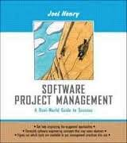
Henry, McConnell: "microstones"
Both advocate "microstones":
i.e.,small, clearly defined goals
▪ McConnell: < 1 week, ≥ 1 day
Rationale (McConnell)
▪ More immediate indicators of group progress
▪ Help users focus on required tasks
Like all good software project plans, this book's approach is based on the reality that mistakes will be made throughout the project. Project success depends on positioning the project team to detect and correct these mistakes quickly and easily.
-- Steve McConnell, Software Project Survival Guide

Slide 19
4. Verifying Scope
Formalizing scope, getting sponsor sign-off
5. Controlling Scope
Tracking variances in schedule
Determining if corrective or preventative action is required

